Slide 1
OpenGL Shading Language
Advanced Graphics Programming

Slide 2
What is GLSL
GLSL: Graphics Library Shading Language
Syntax similar to C/C++
Language used to write shaders
Vertex, fragment, geometry, tessellation, compute
First available in OpenGL 2.0 (2004)
Alternatives
Nvidia Cg
Microsoft HLSL

Slide 3
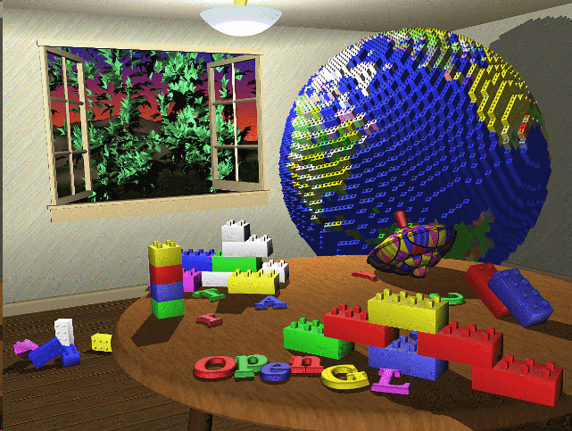
Without GLSL
OpenGL 25 years ago
No programmable pipeline
Graphics cards had a very limited set of operations
Vertex transform / fragment shading was hardcoded into GPUs

Slide 4
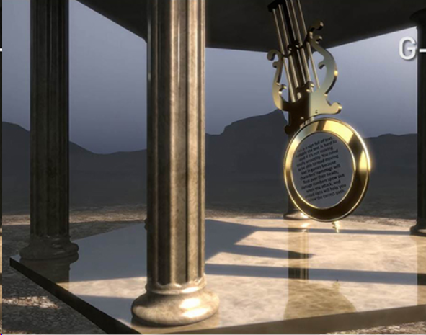
With GLSL
Modern OpenGL
More parts of the GPU are programmable (but not all)
Vertex processor
Fragment processor
The flexibility of programmable shaders allows the creation of astonishing visual effects

Slide 5


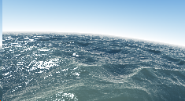
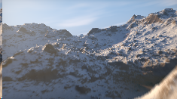
Take a look...
Even big procedural worlds can be created within the fragment processor.
GPU intensive
Difficult maths :_D
Some examples:
https://www.shadertoy.com/
https://www.shadertoy.com/results?query=landscape
https://www.shadertoy.com/results?query=reflections

Slide 6
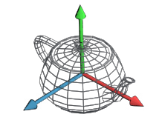
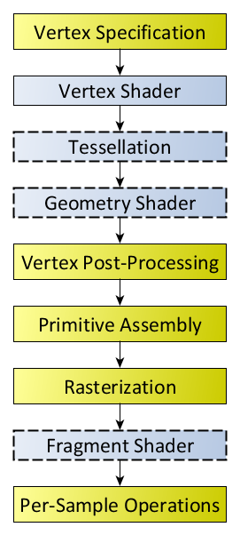

What is a shader program?
A small program that controls parts of the graphics pipeline
Consists of at least 2 separate parts
Vertex shader (controls vertex transforms)
Fragment shader (controls fragment shading)
Can also contain
Geometry shader (controls additional geometry generation)
Tessellation shader (controls primitive tessellation)

Slide 7
How do we use them?
Create a shader program
Attach some shaders to it
At least a vertex and a fragment shader
Each stage needs its main() function
Link the program
We must specify which program to use before drawing any geometry.
At any time, the GPU runs only one program

Slide 8
Data flow in shaders
Application
Configure uniforms
Primitives / vertex attributes (position, normal, tex coords…)
Vertex program
gl_Position & custom vertex outputs
Uniform variables
Rasterizer
Per-fragment interpolation of vertex outputs
Interpolated fragment inputs
Uniform variables are specified in a per-mesh basis
Fragment program
Framebuffer
Color, depth, ...

Slide 9
Data types
// booleans
bool
bvec2
bvec3
bvec4
// integers
int
ivec2
ivec3
ivec4
// floats
float
vec2
vec3
vec4
// matrices
mat2
mat3
mat4
// some variable definitions
bool b;
int i;
float v;
vec2 texCoord;
vec3 rgbColor;
vec4 position;
mat3 rotationMatrix;
mat4 transformMatrix;
// u. integers
uint
uvec2
uvec3
uvec4
// double
double
dvec2
dvec3
dvec4
// matrices (doubles)
dmat2
dmat3
dmat4

Slide 10
Data types
// GLSL type // OpenGL texture type
sampler1D GL_TEXTURE_1D
sampler2D GL_TEXTURE_2D
sampler3D GL_TEXTURE_3D
samplerCube GL_TEXTURE_CUBE_MAP
sampler2DRect GL_TEXTURE_RECTANGLE
sampler1DArray GL_TEXTURE_1D_ARRAY
sampler2DArray GL_TEXTURE_2D_ARRAY
samplerCubeArray GL_TEXTURE_CUBE_MAP_ARRAY
samplerBuffer GL_TEXTURE_BUFFER
sampler2DMS GL_TEXTURE_2D_MULTISAMPLE
sampler2DMSArray GL_TEXTURE_2D_MULTISAMPLE_ARRAY
These are sampler for standard color textures
Color values will have values from 0 to 1.
The prefixes i (isampler), and u (usampler) can be used for textures storing integers.
Used for uniform inputs.

Slide 11
Data types
Reference
For more information about GLSL data types, visit the wiki reference page at khronos.org:
https://www.khronos.org/opengl/wiki/Data_Type_(GLSL)

Slide 12
Vertex attributes (vertex shader inputs)
Application
Configure uniforms
Primitives / vertex attributes (position, normal, tex coords…)
Vertex program
gl_Position & custom vertex outputs
Uniform variables
Rasterizer
Per-fragment interpolation of vertex outputs
Interpolated fragment inputs
Uniform variables are specified in a per-mesh basis
Fragment program
Framebuffer
Color, depth, ...

Slide 13
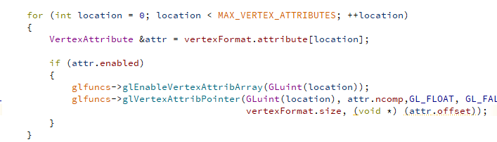
Vertex attributes (vertex shader inputs)
Recall that our meshes’ vertex attributes were assigned a specific location...

Slide 14
Vertex attributes (vertex shader inputs)
Those attributes are the inputs of vertex shaders.
The previously configured location of attributes in the mesh and the attribute locations specified in the shader must match!!!
layout(location=0) in vec3 position;
layout(location=1) in vec3 normal;
layout(location=2) in vec2 texCoords;
layout(location=3) in vec3 tangent;
layout(location=4) in vec3 bitangent;

Slide 15
Uniform variables (any shader inputs)
Application
Configure uniforms
Primitives / vertex attributes (position, normal, tex coords…)
Vertex program
gl_Position & custom vertex outputs
Uniform variables
Rasterizer
Per-fragment interpolation of vertex outputs
Interpolated fragment inputs
Uniform variables are specified in a per-mesh basis
Fragment program
Framebuffer
Color, depth, ...

Slide 16
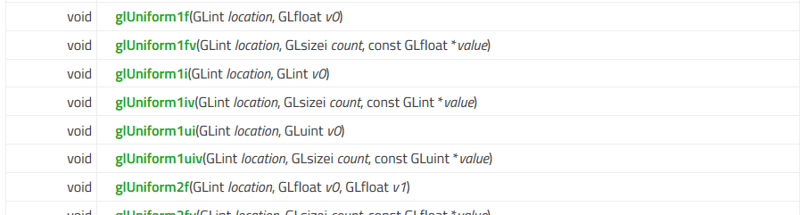
Uniform variables (setting them in OpenGL)
And many more….

Slide 17
Uniform variables (setting them in Qt)
The class provided by Qt, QOpenGLShaderProgram, also provides convenience methods to send many types defined by Qt:
QVector3D
QMatrix4x4
QColor...
// Send the material to the shader
program.setUniformValue("albedo", material->albedo);
program.setUniformValue("specular", material->specular);
program.setUniformValue("smoothness", material->smoothness);
int textureUnit = 0;
program.setUniformValue("albedoTexture", textureUnit);
material->textureAlbedo.bind(textureUnit);
int textureUnit = 1;
program.setUniformValue("normalMap", textureUnit);
material->textureNormal.bind(textureUnit);

Slide 18
Uniform variables (setting them in Qt)
In shader code, uniform variables are specified with the uniform keyword preceding the data type:
QVector3D objects map to vec3
QVector4D objects map to vec4
QColor objects map to vec4 (contain alpha)
QMatrix4x4 objects map to mat4
// Material
uniform vec4 albedo;
uniform vec4 specular;
uniform float smoothness;
uniform sampler2D albedoTexture;
uniform sampler2D normalMap;

Slide 19
Uniform variables
For more information about GLSL uniform variables, visit the wiki reference page at khronos.org:
https://www.khronos.org/opengl/wiki/Built-in_Variable_(GLSL)

Slide 20
VS outputs / FS inputs
Application
Configure uniforms
Primitives / vertex attributes (position, normal, tex coords…)
Vertex program
gl_Position & custom vertex outputs
Uniform variables
Rasterizer
Per-fragment interpolation of vertex outputs
Interpolated fragment inputs
Uniform variables are specified in a per-mesh basis
Fragment program
Framebuffer
Color, depth, ...

Slide 21
VS outputs / FS inputs
// Vertex shader custom output
out Data
{
vec3 positionLocalSpace;
} VSOut;
void main(void)
{
// Will go to the fragment shader
VSOut.positionLocalSpace = attributePosition;
// Vertex shader output
gl_Position = projectionMatrix *
worldViewMatrix *
vec4(VSOut.positionLocalSpace, 1.0);
}
// Fragment shader input (comes from VS)
in Data
{
vec3 positionLocalSpace;
} FSIn;
void main(void)
{
// ...
vec3 positionWorldspace = (
worldMatrix *
vec4(FSIn.positionLocalSpace, 1.0)).xyz;
// ...
}

Slide 22
VS outputs / FS inputs
// Vertex shader custom output
out vec3 positionLocalSpace;
void main(void)
{
// Will go to the fragment shader
VSOut.positionLocalSpace = attributePosition;
// Vertex shader output
gl_Position = projectionMatrix *
worldViewMatrix *
vec4(positionLocalSpace, 1.0);
}
// Fragment shader input (comes from VS)
in vec3 positionLocalSpace;
void main(void)
{
// ...
vec3 positionWorldspace = (
worldMatrix *
vec4(positionLocalSpace, 1.0)).xyz;
// ...
}

Slide 23
Fragment shader outputs
We need to define the outputs in the fragment shader.
They need to match the framebuffer pixel format.
The default framebuffer pixel format is an 8-bit RGBA color (so vec4).
In the following lectures we will learn how to create multi-layered framebuffers.
out vec4 outColor; // Output
void main(void)
{
// ...
outColor = shadeFragment(
fragmentPosition,
fragmentAlbedo,
fragmentSmoothness,
fragmentMetalness);
}

Slide 24
Built-in variables
// Vertex processor inputs
in int gl_VertexID;
in int gl_InstanceID;
// ...
// Vertex processor outputs
out gl_PerVertex {
vec4 gl_Position;
float gl_PointSize;
float gl_ClipDistance[];
};
// Fragment processor inputs
in vec4 gl_FragCoord;
in bool gl_FrontFacing;
in vec2 gl_PointCoord;
// Fragment processor outputs
out float gl_FragDepth;

Slide 25
Built-in variables (vertex shader output)
out vec4 gl_Position;
The clip-space output position of the current vertex.
It is mandatory setting this value in our vertex shaders.
Sometimes we will transform our meshes by multiplying each vertex by a model-view-projection matrix.
In other situations we will only let the vertex position attributes of our geometry pass through (for example to render a screen-filling quad).

Slide 26
Built-in variables (fragment shader input)
in vec4 gl_FragCoord;
These are the current fragment coordinates.
X and Y contain the coordinates of the center of the current fragment in pixels w.r.t. the viewport. The bottom-left fragment contains (0.5, 0,5).
The Z value is the projected, non-linear depth in the range [0, 1].
The W component is 1/Wclip, where Wclip is the interpolated W component of the clip-space vertex position output to gl_Position from the Vertex processing stage.

Slide 27
Built-in variables (fragment shader output)
out float gl_FragDepth;
This is the fragment depth. If the shader does not write to it, it will receive the value in gl_FragCoord.z automatically.
Not used a lot, but sometimes is useful (e.g. relief mapping).
Disables early z-test (as the final value of z is not now until the fragment processor has been executed).
Cannot write conditionally to it.

Slide 28
Built-in variables
Reference
For more information about GLSL built-in variables, visit the wiki reference page at khronos.org:
https://www.khronos.org/opengl/wiki/Built-in_Variable_(GLSL)

Slide 29
Built-in functions
GLSL provides fairly big set of functions to develop shaders
Mathematics
GPU-accelerated
Efficient
Texture lookups

Slide 30
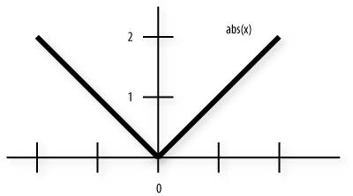
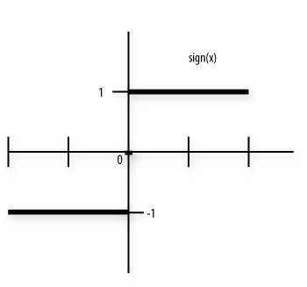
Built-in functions: Abs / Sign
// Returns x if x >= 0; otherwise, it returns -x.
float abs (float x)
vec2 abs (vec2 x)
vec3 abs (vec3 x)
vec4 abs (vec4 x)
// Returns 1.0 if x > 0, 0.0 if x = 0, or -1.0 if x < 0.
float sign (float x)
vec2 sign (vec2 x)
vec3 sign (vec3 x)
vec4 sign (vec4 x)

Slide 31
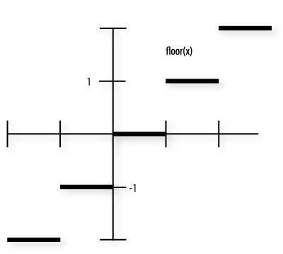
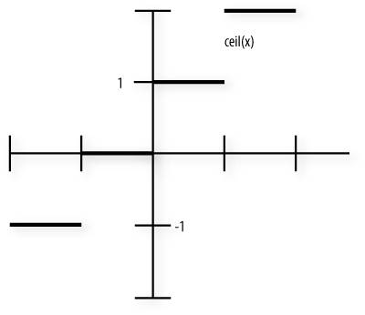
Built-in functions: Floor / Ceil
// Returns a value equal to the nearest integer that is
// less than or equal to x.
float floor (float x)
vec2 floor (vec2 x)
vec3 floor (vec3 x)
vec4 floor (vec4 x)
// Returns a value equal to the nearest integer that is
// greater than or equal to x.
float ceil (float x)
vec2 ceil (vec2 x)
vec3 ceil (vec3 x)
vec4 ceil (vec4 x)

Slide 32
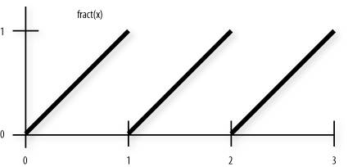
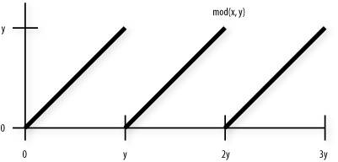
Built-in functions: Fract / mod
// Returns x - floor (x).
float fract (float x)
vec2 fract (vec2 x)
vec3 fract (vec3 x)
vec4 fract (vec4 x)
// Modulus. Returns x - y * floor (x/y) for each
// component in x using the floating-point value y.
float mod (float x, float y)
vec2 mod (vec2 x, float y)
vec3 mod (vec3 x, float y)
vec4 mod (vec4 x, float y)
// Modulus. Returns x - y * floor (x/y) for each
// component in x using the corresponding component of y.
vec2 mod (vec2 x, vec2 y)
vec3 mod (vec3 x, vec3 y)
vec4 mod (vec4 x, vec4 y)

Slide 33
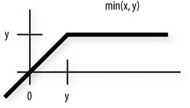
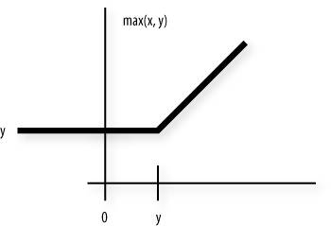
Built-in functions: Min / Max
// Returns minimum of each component of x compared with the floating-point value y.
vec2 min (vec2 x, float y)
vec3 min (vec3 x, float y)
vec4 min (vec4 x, float y)
// Returns y if x < y; otherwise, it returns x.
float max (float x, float y)
vec2 max (vec2 x, vec2 y)
vec3 max (vec3 x, vec3 y)
vec4 max (vec4 x, vec4 y)
// Returns maximum of each component of x compared
// with the floating-point value y.
vec2 max (vec2 x, float y)
vec3 max (vec3 x, float y)
vec4 max (vec4 x, float y) // and more...

Slide 34
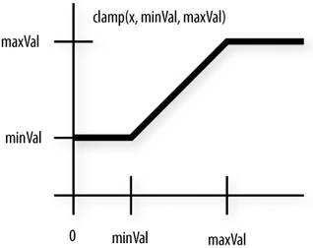
Built-in functions: Clamp
// Returns min (max (x, minVal), maxVal) for each
// component in x using the floating-point values minVal
// and maxVal. Results are undefined if minVal > maxVal.
float clamp (float x, float minVal, float maxVal)
vec2 clamp (vec2 x, float minVal, float maxVal)
vec3 clamp (vec3 x, float minVal, float maxVal)
vec4 clamp (vec4 x, float minVal, float maxVal)
// Returns the component-wise result of min (max (x,
// minVal), maxVal). Results are undefined if minVal >
// maxVal.
vec2 clamp (vec2 x, vec2 minVal, vec2 maxVal)
vec3 clamp (vec3 x, vec3 minVal, vec3 maxVal)
vec4 clamp (vec4 x, vec4 minVal, vec4 maxVal)

Slide 35
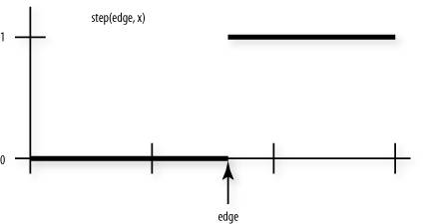
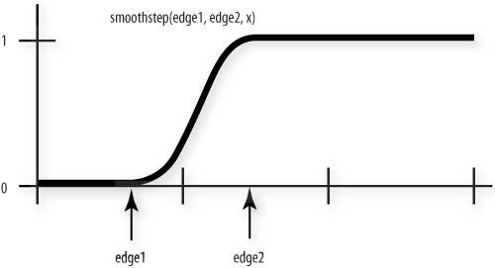
Built-in functions: Step / Smoothstep
// Returns 0 if x < edge; otherwise, it returns 1.0.
float step (float edge, float x)
vec2 step (vec2 edge, vec2 x)
vec3 step (vec3 edge, vec3 x)
vec4 step (vec4 edge, vec4 x)
// Returns 0 if x <= edge0 and 1.0 if x >= edge1 and
// performs smooth Hermite interpolation between 0 and 1
// when edge0 < x < edge1. Results are undefined if
// edge0 >= edge1.
float smoothstep (float edge0, float edge1, float x)
vec2 smoothstep (vec2 edge0, vec2 edge1, vec2 x)
vec3 smoothstep (vec3 edge0, vec3 edge1, vec3 x)
vec4 smoothstep (vec4 edge0, vec4 edge1, vec4 x)

Slide 36
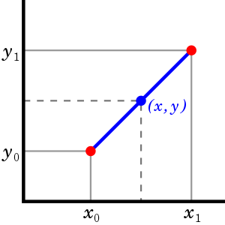
Built-in functions: Mix
// Returns x * (1.0 - a) + y * a, i.e., the linear blend
// of x and y using the floating-point value a. The value
// for a is not restricted to the range [0,1].
float mix (float x, float y, float a)
vec2 mix (vec2 x, vec2 y, float a)
vec3 mix (vec3 x, vec3 y, float a)
vec4 mix (vec4 x, vec4 y, float a)
// Returns the component-wise result of x * (1.0 - a) + y
// * a, i.e., the linear blend of vectors x and y using
// the vector a. The value for a is not restricted to the
// range [0,1].
vec2 mix (vec2 x, vec2 y, vec2 a)
vec3 mix (vec3 x, vec3 y, vec3 a)
vec4 mix (vec4 x, vec4 y, vec4 a)

Slide 37
Built-in functions: Many others
Trigonometry
Sin, cos, tan, asin, acos, atan… // In radians!
Exponential
Pow, exp2, log2, sqrt, inversesqrt...
Geometric
Length, distance, dot, cross, normalize, reflect, refract…
Texture lookup
Before: texture1D, texture2D, texture3D, textureCube
Now: texture (overloads for all texture types)
Texture info
textureSize

Slide 38
OpenGL Shading Language
Reference
For more information about GLSL, visit the wiki reference page at khronos.org:
https://www.khronos.org/opengl/wiki/OpenGL_Shading_Language

